Slide 1

Department of Computer Science, CUI Lahore Campus
Formal Methods in Software Engineering
By
Farooq Ahmad

Slide 2
Introduction to Formal Methods
Propositional Logic

Slide 3
Topics to be discussed
proposition
Compound proposition
Logical connectives

Slide 4
Need of propositional logic
Mathematical logic (the branch of pure mathematics) gives the compact representation of sentences.
Mathematical logic provides a precise and agreed meaning to statements made in a natural language such as English.
The role of logic is to enable the reason about the proposed system specifications.
Logic provides us such a rigorous framework that makes it possible to reason precisely about statements made in the natural language.
It allows us to develop a set of laws that are internally consistent.

Slide 5
LOGICAL STATEMENT
A statement is a declarative sentence that is either true or false but not both.
A statement is also referred to as a proposition. So when we say a statement or Proposition this must be clear to you that these are the same.
Propositions are statements that are either TRUE or FALSE.
If a proposition is true, we say that it has a truth value of "true”.
If a proposition is false, its truth value is "false".
The truth values “true” and “false” are, respectively, denoted by the letters T and F.

Slide 6
EXAMPLES OF STATEMENTS OR PROPOSITIONS:
There are seven days in a week
4 + 2 = 6
4 + 2 = 6 is also a statement and its truth value is T. (Because 4+2 is 6)
4 + 2 = 7 is also a statement and its truth value is F. (Because we know that 4+2 is 6 not 7).
The angles of a triangle add up to 360

Slide 7
More examples of the proposition
London is the capital of France.
2. Washington, D.C, is the capital of the United States of America.
The above statement is also a proposition and its truth value is T.
3. Karachi is the capital of Pakistan. Karachi is the capital of Pakistan is also a statement and its truth value is F.
4. Imran is the president of America.
The above sentence is a statement and its Truth value is false.
REMARK: Every sentence is not a statement.

Slide 8
EXAMPLES OF SENTENCES WHICH ARE NOT PROPOSITIONS:
Consider the following sentences
Close the door.
x is greater than 2.
He is very rich
What time is it ?
Read this carefully.
x + z = 10
are not propositions.

Slide 9
Sentence as proposition
If sentence is a question or command , or it is vague or nonsensical, then it cannot be classified as true or false then the sentence cannot be a statement or proposition, as easily seen in the sentences.
The statements which involve variable or pronoun and there are some information about the variable or pronoun which make the role of variable clear then the sentence becomes statement.

Slide 10
More on propositions
For example in the expression x + z =10, if we say that x=3 and z=7 then this become a statement and its truth value is T and if we say x=8 and z=4 then the sentence has its truth value as F.
Here is the rule given below:
RULE
If the sentence is preceded by other sentences that make the pronoun or variable reference clear, then the sentence is a statement.

Slide 11
EXAMPLES
x = 1 is a sentence which gives us the information about the variable which is in the below sentence.
x > 2 now using the value above we can see that our sentence takes the form 1 > 2 now we can talk about its truth value . So x > 2 is a statement with truth-value FALSE.
Similarly in the next example

Slide 12
UNDERSTANDING STATEMENTS
x + 2 is positive.
The above sentence is not a statement because it is true for some value of x and false for some values of x. We can say that the truth value of the statement is vague
2. May I come in?
The above sentence is permission and hence we can't talk about its truth values so it is also not a statement.

Slide 13
More examples
Logic is interesting.
Logic is interesting in a statement because logic is interesting and its truth value is T.
It is hot today.
It is hot today is also a statement because whenever we say this sentence then that day either hot or not so we can assign a truth value to this sentence.
5. -1 > 0 is also a statement with truth value F
x + y = 12 is not a statement.

Slide 14
Variable representation of propositions
An indivisible proposition is called an atom, or atomic proposition
In mathematics we often represent a proposition symbolically by a variable name such as P or Q.
For example:
P: I go shopping on Wednesdays
Q: 102.01 > 101.31

Slide 15
Propositions can be represented as propositional variables
The system is in shut-down mode.
The ALARM command has been typed.
An update file has been created.
No sign-off messages have been received in the past hour.

Slide 16
Example (variable or symbolic representation)
For example, the proposition “the escape valve is open” can be represented by the propositional variable esc_valve_open
the proposition “the reactor is in an error state” can be represented as the propositional variable in_error_state.
Such propositional variables can have true (T) values or false (F) values.

Slide 17
SYMBOLIC REPRESENTATION
Statements are symbolically represented by letters such as p, q, r,...
EXAMPLES
p = “Islamabad is the capital of Pakistan”
q = “16 is divisible by 5”

Slide 18
COMPOUND STATEMENT
Simple or atomic propositions can be combined into compound statements by operators called logical connectives.
Simple statements could be used to build a compound statement.
“4 + 3 = 7” and “Lahore is a city in Pakistan”
Here 3 + 2 = 5 is a statement and Lahore is a city in Pakistan is another statement we combine these two statements by using and to form another statement and you can talk about its truth value.
Similarly in the next example we combine two statements by using or to form another statement.
2. “ 3 > 2” or “Monday is a working day ”

Slide 19
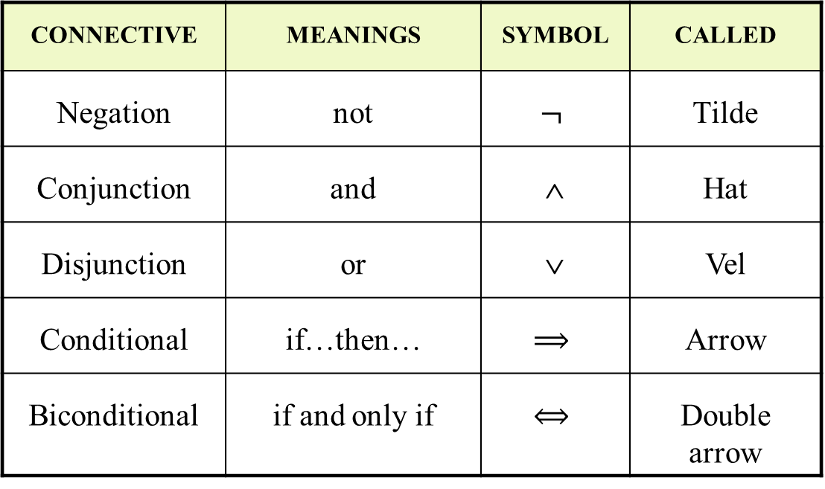
LOGICAL CONNECTIVES
CONNECTIVE | MEANINGS | SYMBOL | CALLED
Negation | not | $$¬$$ | Tilde
Conjunction | and | ∧ | Hat
Disjunction | or | ∨ | Vel
Conditional | if…then… | $$⟹$$ | Arrow
Biconditional | if and only if | $$⟺$$ | Double arrow
Negation is monadic while other operators are dyadic

Slide 20
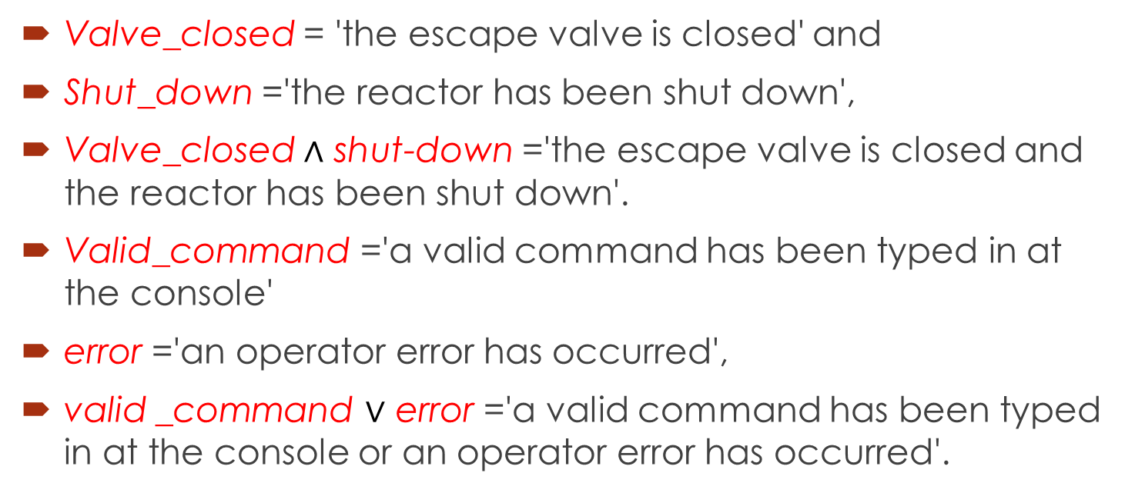
EXAMPLES
Valve_closed = 'the escape valve is closed' and
Shut_down ='the reactor has been shut down',
Valve_closed $∧$ shut-down ='the escape valve is closed and the reactor has been shut down'.
Valid_command ='a valid command has been typed in at the console'
error ='an operator error has occurred',
valid _command $∨$ error ='a valid command has been typed in at the console or an operator error has occurred'.

Slide 21
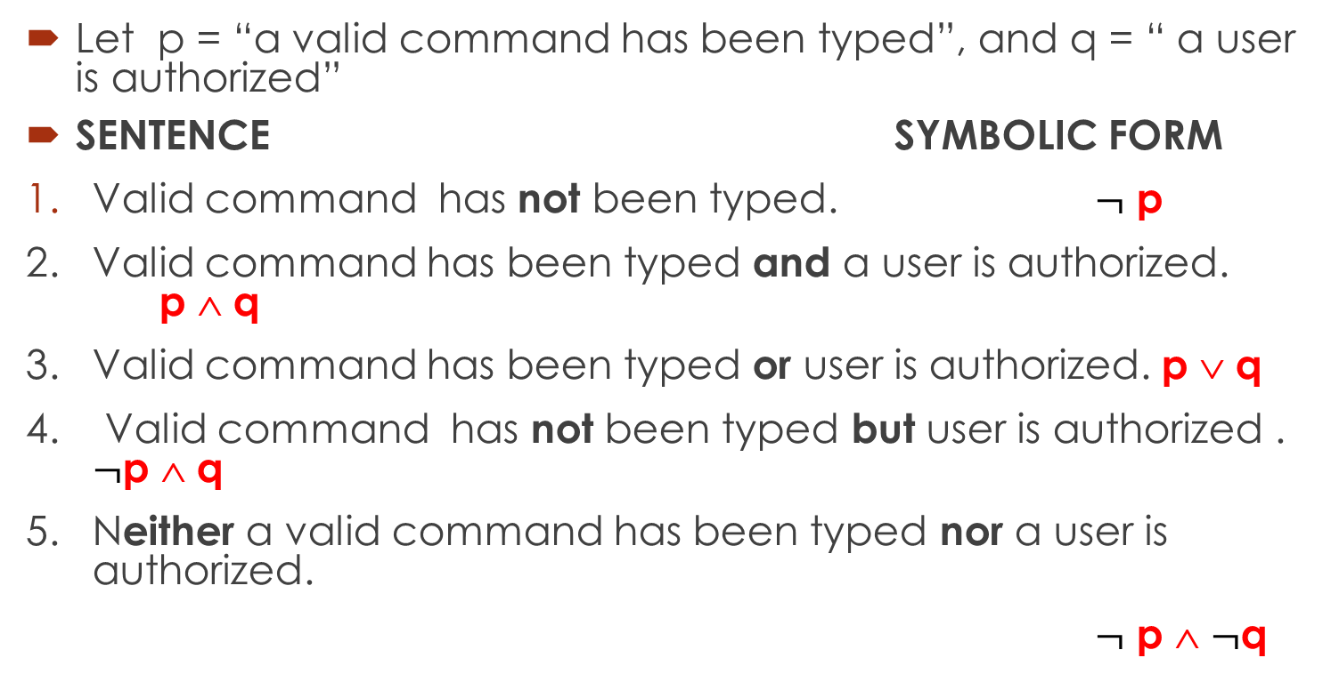
TRANSLATING FROM ENGLISH TO SYMBOLS
Let p = “a valid command has been typed”, and q = “ a user is authorized”
SENTENCE SYMBOLIC FORM
Valid command has not been typed. $¬$ p
2. Valid command has been typed and a user is authorized. p ∧ q
3. Valid command has been typed or user is authorized. p ∨ q
4. Valid command has not been typed but user is authorized . $¬$p ∧ q
5. Neither a valid command has been typed nor a user is authorized.
$¬$ p ∧ $¬$q

Slide 22
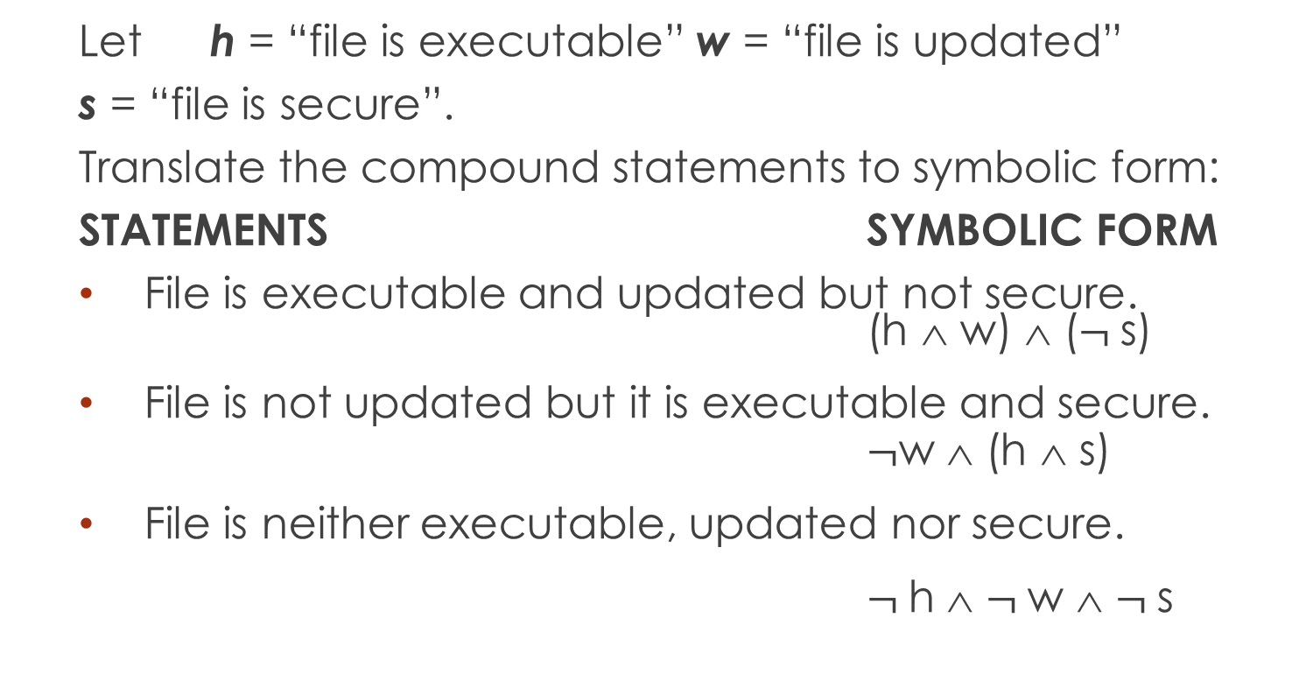
EXAMPLE
Let h = “file is executable” w = “file is updated”
s = “file is secure”.
Translate the compound statements to symbolic form:
STATEMENTS SYMBOLIC FORM
File is executable and updated but not secure. (h ∧ w) ∧ ($¬$s)
File is not updated but it is executable and secure. $¬$w ∧ (h ∧ s)
File is neither executable, updated nor secure.
$¬$h ∧ $¬$w ∧ $¬$s

Slide 23
TRUTH TABLE
A convenient method for analyzing a compound statement is to make a truth table for it.
A truth table specifies the truth value of a compound proposition for all possible truth values of its propositions.
The truth values “true” and “false” are respectively denoted by the letters T and F.

Slide 24
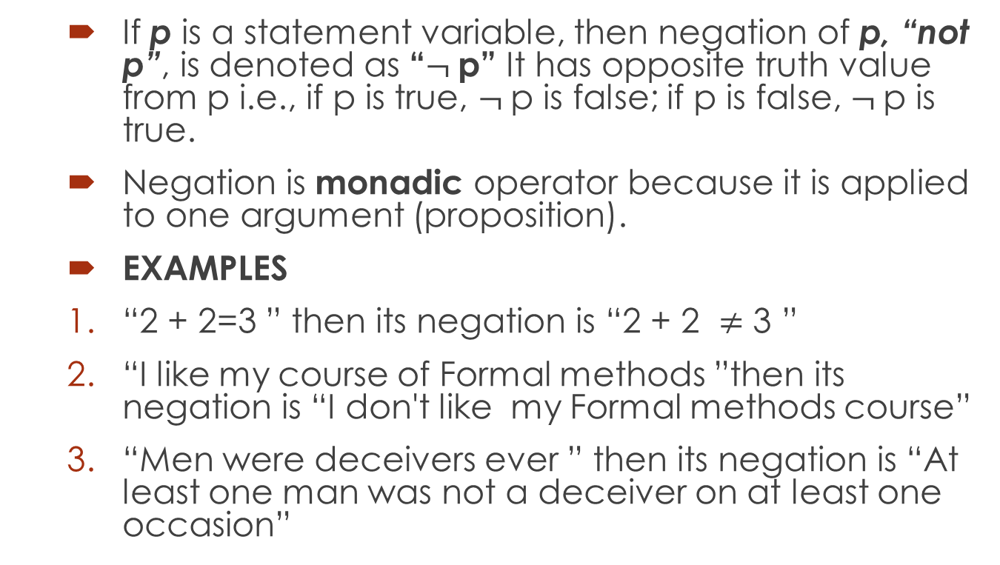

NEGATION ($¬$)
If p is a statement variable, then negation of p, “not p”, is denoted as “$¬$p” It has opposite truth value from p i.e., if p is true, $¬$p is false; if p is false, $¬$p is true.
Negation is monadic operator because it is applied to one argument (proposition).
EXAMPLES
“2 + 2=3 ” then its negation is “2 + 2 $≠$ 3 ”
“I like my course of Formal methods ”then its negation is “I don't like my Formal methods course”
“Men were deceivers ever ” then its negation is “At least one man was not a deceiver on at least one occasion”

Slide 25
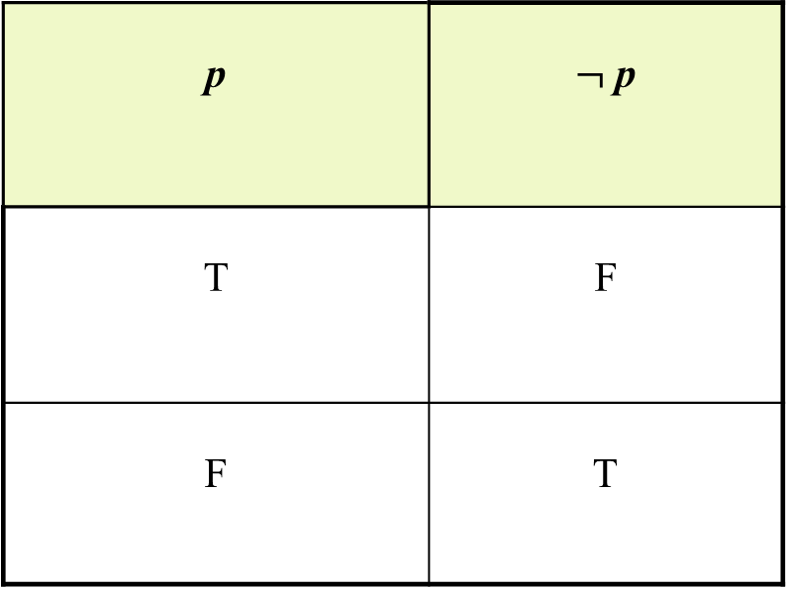

TRUTH TABLE FOR < $¬$ p >
p | $¬$ p
T | F
F | T

Slide 26
CONJUNCTION (∧)
If p and q are statements, then the conjunction of p and q is “p and q”, denoted as “p ∧ q”.
It is true when, and only when, both p and q are true. If either p or q is false, or if both are false, p∧q is false.
p | q | p ∧ q
T | T | T
T | F | F
F | T | F
F | F | F

Slide 27
Note: Truth value of p ∧ q
In the table T is only in that row where both p and q have T and all other values are F.
Thus for finding out the truth values for the conjunction of two statements we will only first search out where the both statements are true
And write down the T in the corresponding row in the column of p ∧ q and in all other rows we will write F in the column of p ∧ q.

Slide 28
DISJUNCTION (∨) or INCLUSIVE OR
If p and q are statements, then the disjunction of p and q is “p or q”, denoted as “p ∨ q” It is true when at least one of p or q is true and is false only when both p and q are false.
p | q | p ∨ q
T | T | T
T | F | T
F | T | T
F | F | F

Slide 29
Note: Truth value of p ∨ q
In the table F is only in that row where both p and q have F and all other values are T.
Thus for finding out the truth values for the disjunction of two statements we will only first search out where the both statements are false.
And write down the F in the corresponding row in the column of p ∨ q and in all other rows we will write T in the column of p ∨ q.

Slide 30
USAGE OF “OR” IN INCLUSIVE SENSE
I shall buy a pen or a book.
In the above statement, if you buy a pen or a book in both cases the statement is true,
and if you buy both pen and book then statement is again true. Thus we say in the above statement we use or in inclusive sense. (p or q or both).

Slide 31
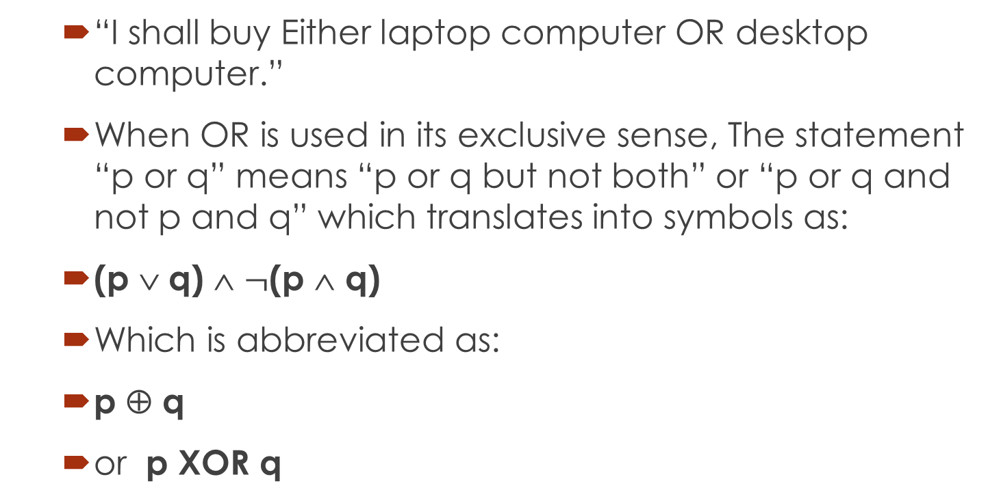
EXCLUSIVE OR
“I shall buy Either laptop computer OR desktop computer.”
When OR is used in its exclusive sense, The statement “p or q” means “p or q but not both” or “p or q and not p and q” which translates into symbols as:
(p ∨ q) ∧ $¬$(p ∧ q)
Which is abbreviated as:
p ⊕ q
or p XOR q

Slide 32
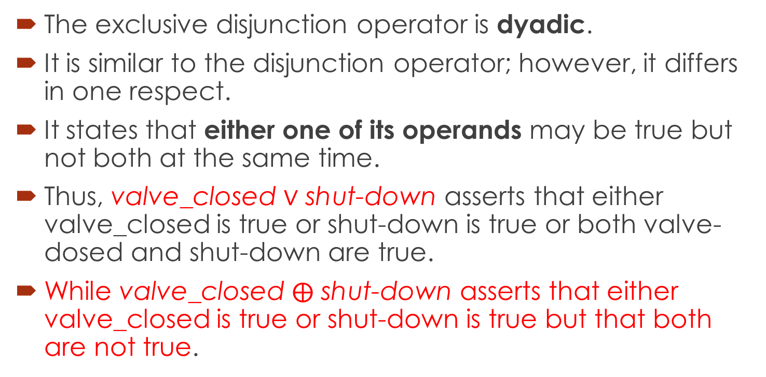

Difference between $∨$ and $⊕$
The exclusive disjunction operator is dyadic.
It is similar to the disjunction operator; however, it differs in one respect.
It states that either one of its operands may be true but not both at the same time.
Thus, valve_closed $∨$ shut-down asserts that either valve_closed is true or shut-down is true or both valve-dosed and shut-down are true.
While valve_closed $⨁$ shut-down asserts that either valve_closed is true or shut-down is true but that both are not true.

Slide 33

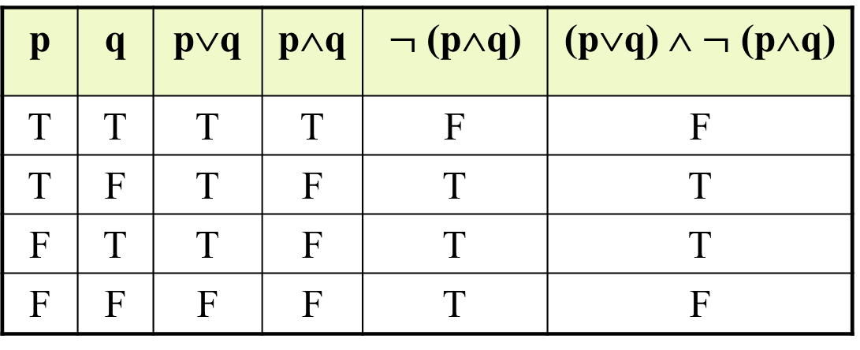
TRUTH TABLE FOR EXCLUSIVE OR
p ⊕ q = (p ∨ q) ∧ $¬$(p ∧ q)
p | q | p∨q | p∧q | $¬$ (p∧q) | (p∨q) ∧ $¬$ (p∧q)
T | T | T | T | F | F
T | F | T | F | T | T
F | T | T | F | T | T
F | F | F | F | T | F

Slide 34
Summary of the lecture: conclusion
What are propositions
Logical connectives
Truth tables

Slide 35
Reference and reading material
Chapter # 3: Section 3.2 of the book “Software development with Z” by J.B. Wordsworth
Chapter # 2: of the book “Formal Software Development, from VDM to Java” by Quentin Charatan and Aaron Kans

